Slide 1
Essential Systems
The Race to a New System
Krysta Albertson, Jordan Gates, Andrew Huff, Adam Passanisi, Nick Phelps, Louis Ries
Kentucky Horsemen’s Benevolent and Protective Association

Slide 2
Agenda
Problem
Prototypes
Financials
Review
System Requirements

Slide 3
Problem Statement
Can’t receive money for reports or donations online
No ability to process forms, claims, memberships, sales bills or reports online
Newsletter not electronically available online
No plan for business continuity

Slide 4
System Requirements
Donations shall be able to be received online.
Reports shall be able to be requested online.
Reports shall be able to be paid for online.
Benefit forms shall be online for members to view in a documents gallery.
The KHBPA shall be able to poll members online.
The website shall drive traffic through the use of social media links.
The system shall have a disaster recovery plan.
The system shall allow for backups.
The website shall allow for users to sign up for a membership online.
The website shall have a member log in page for members to access their accounts.
The website shall have a method for allowing events to get feedback.
The website shall allow users to submit forms.
The website shall have a calendar to show upcoming events.
The website shall allow members or users to upload photos directly to the website.
The website shall have a photo gallery.
The website shall allow the KHBPA to send electronic newsletters.
The website shall allow for newsletter signup requests to be submitted.
The website shall have a contact us section for viewers to send questions to the KHBPA.
The website shall be mobile friendly so that users without a computer can easily navigate the website.
The website shall allow for an admin to manage users accounts.
The website shall allow for employees of the KHBPA information to be shown for contact purposes.

Slide 5
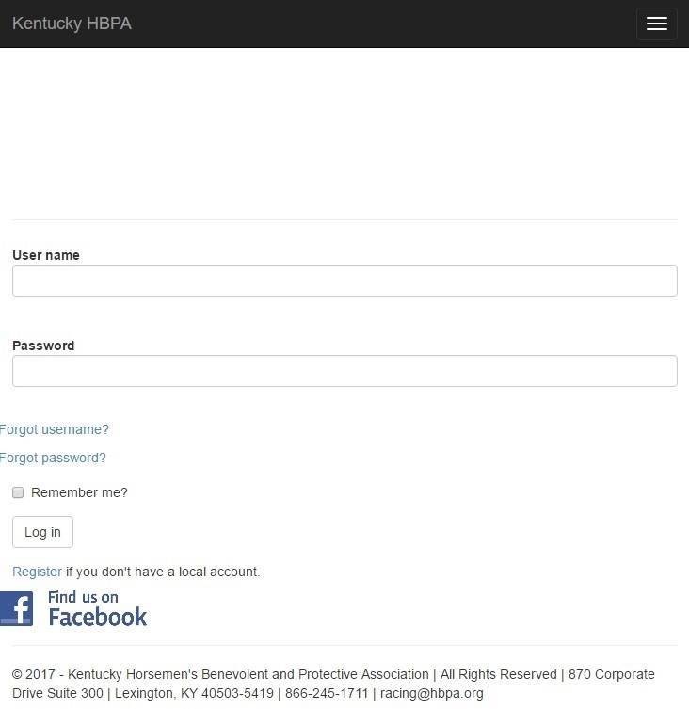
Login Page

Slide 6
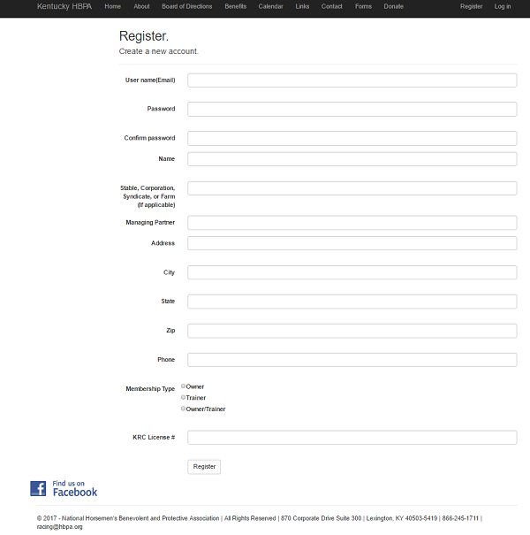
Create Member

Slide 7
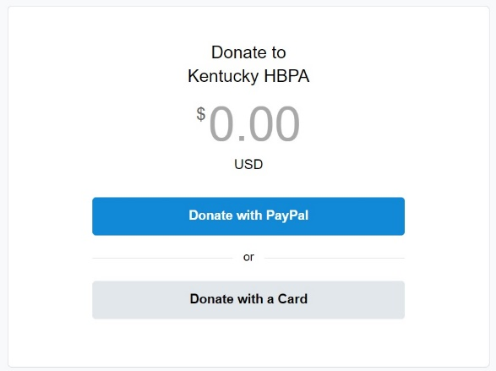

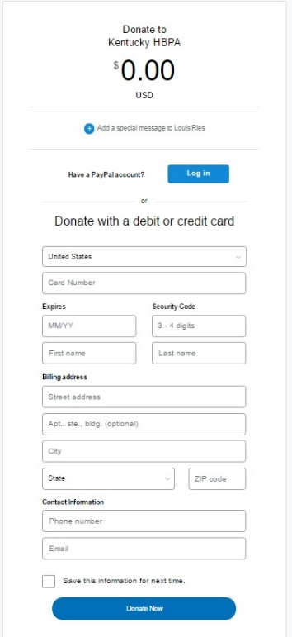
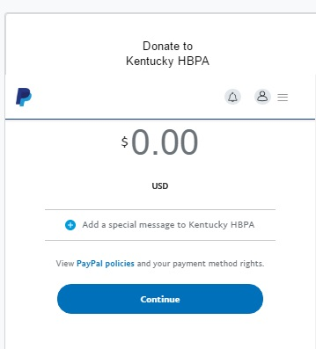
Make a Donation

Slide 8
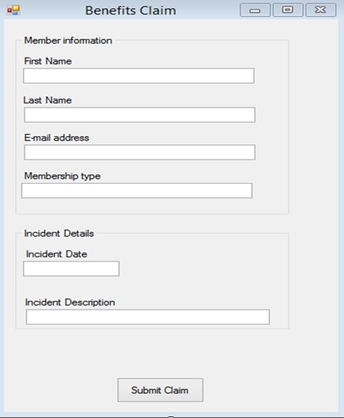
Benefits Claim

Slide 9
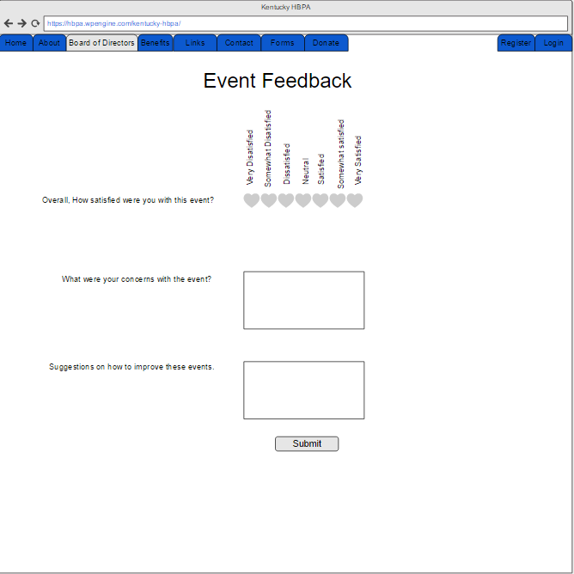
Event Feedback

Slide 10
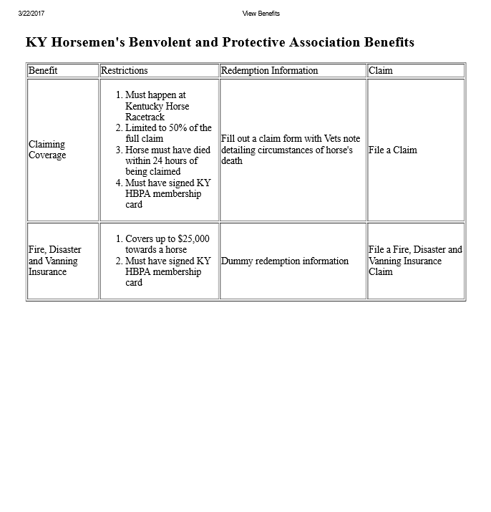
View Benefits

Slide 11
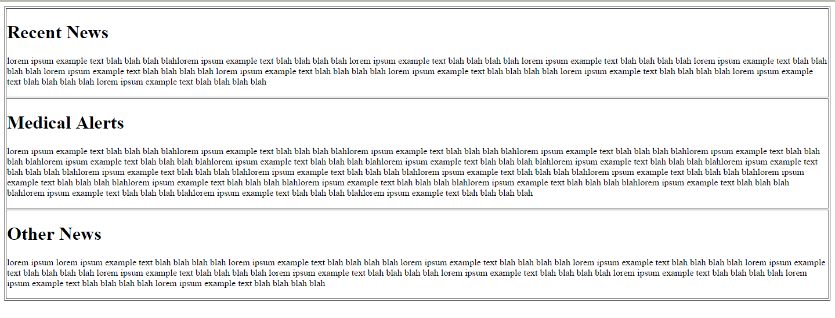
News Feed

Slide 12
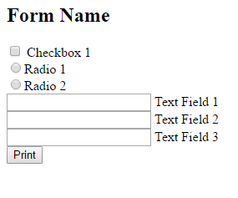
Print Form

Slide 13
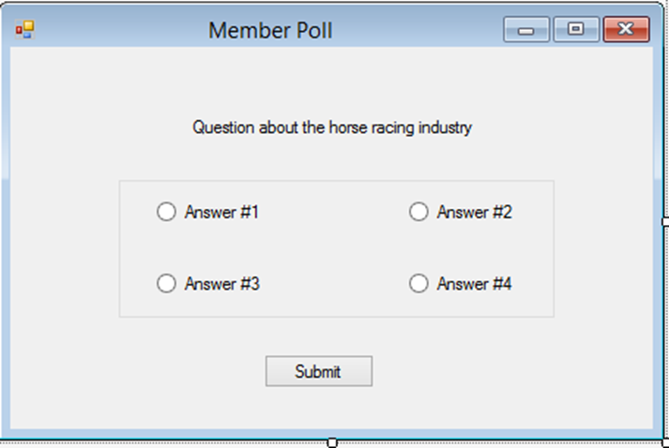
Poll Member

Slide 14
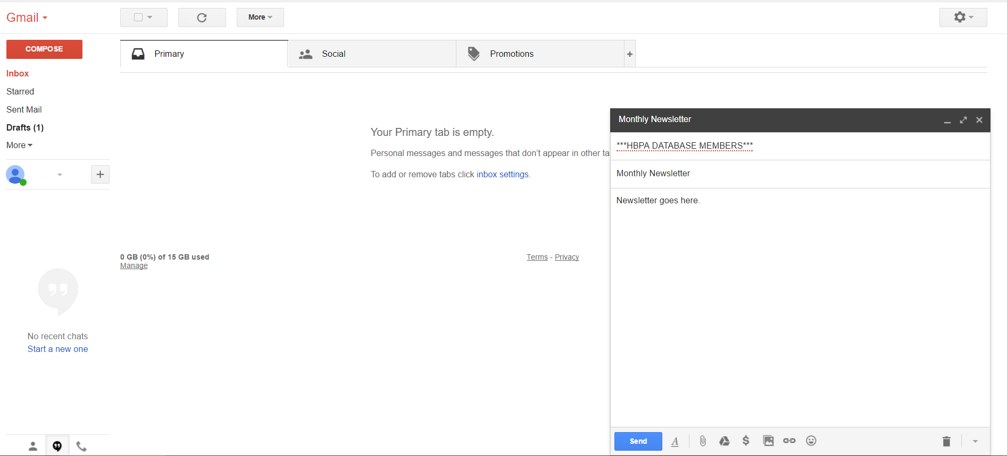
Send Newsletter

Slide 15
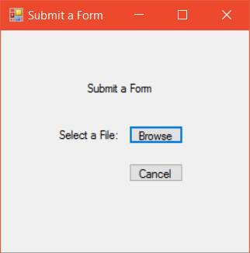
Submit Forms

Slide 16
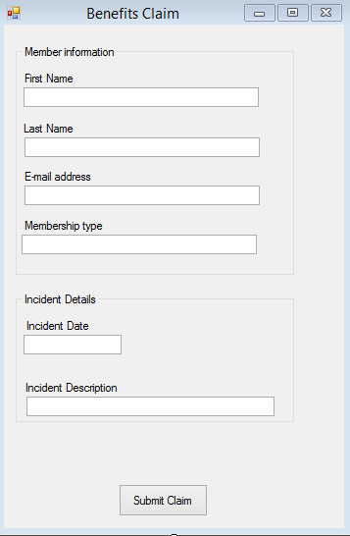
Process Claims

Slide 17
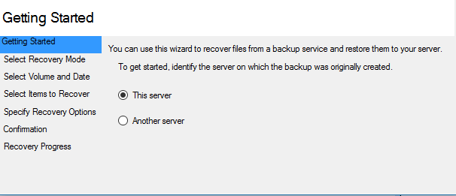

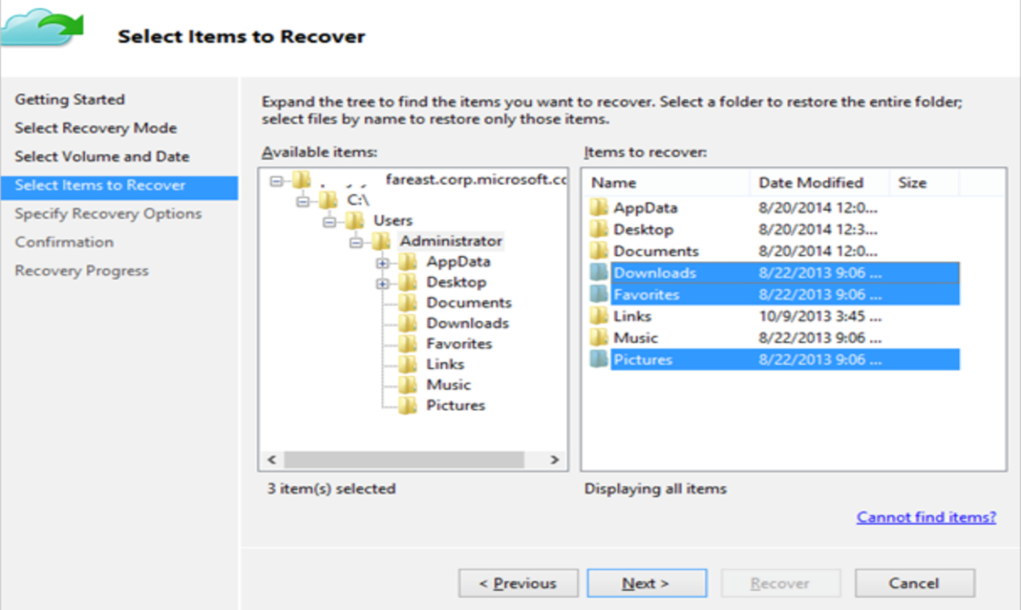
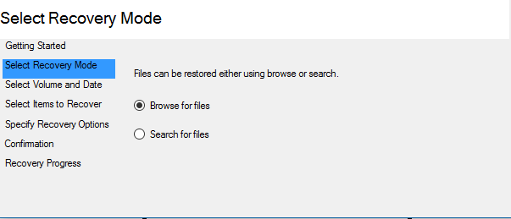
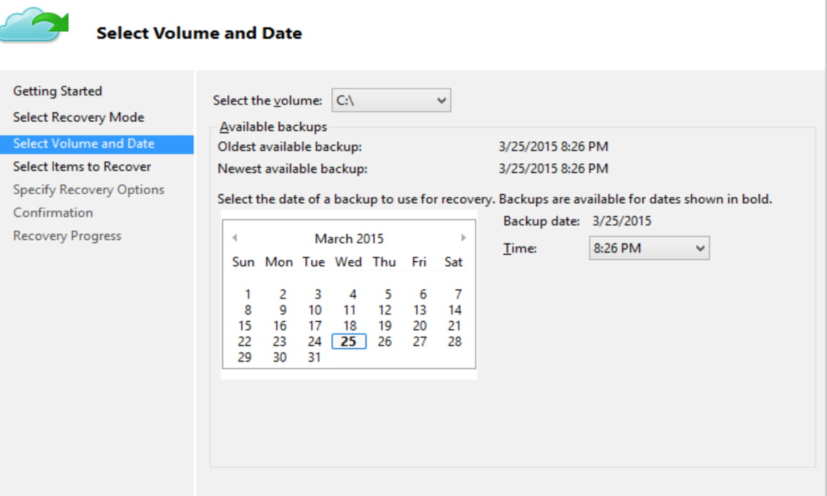
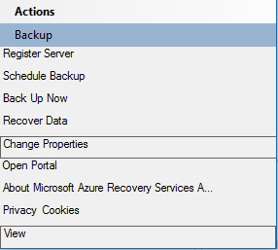
Backup and Recover Data

Slide 18
Economic Benefits
 | 2017 | 2018 | 2019 | 2020 | 2021 | 2022 | Total
Newsletter Savings | 6,000 | 6,126 | 6,255 | 6,386 | 6,520 | 7,889
Disaster Recovery Savings | 10,000 | 10,210 | 10,424 | 10,643 | 10,867 | 11,095
Manual Labor Savings (12hrs/wk @ $20/hr) | 12,000 | 12,252 | 12,509 | 12,772 | 13,040 | 13,314
Online Donations (Avg 175/6mo) | 175 | 179 | 182 | 186 | 190 | 194
Legislative Value | 10,000 | 10,000 | 10,000 | 10,000 | 10,000 | 10,000
TOTAL BENEFITS: | 38,175 | 38,588 | 39,189 | 39,801 | 40,427 | 42,298
PV of BENEFITS: | 37,063 | 26,947 | 26,712 | 26,478 | 26,247 | 27,861 | $ 171,308
PV of ALL BENEFITS: | 37,063 | 64,010 | 90,722 | 117,200 | 143,447 | 171,308

Slide 19
Economic Costs
 | 2017 | 2018 | 2019 | 2020 | 2021 | 2022 | Total
Database Administrator Labor | 15,800 | 0 | 0 | 0 | 0 | 0
Analyst Labor | 12,000 | 0 | 0 | 0 | 0 | 0
Software Developer Labor | 18,000 | 0 | 0 | 0 | 0 | 0
TOTAL DEVELOPMENT COSTS: | 45,800 | 0 | 0 | 0 | 0 | 0
Hosting License | 300 | 0 | 0 | 200 | 200 | 200
Cloud Backup | 119 | 121 | 124 | 127 | 129 | 132
SQL Server | 60 | 61 | 63 | 64 | 65 | 67
TOTAL OPERATIONAL COSTS: | 479 | 183 | 187 | 391 | 395 | 399
TOTAL COSTS: | 46,279 | 183 | 187 | 391 | 395 | 399
PV of COSTS: | 44,931 | 172 | 171 | 347 | 340 | 344 | $ 45,961
PV of ALL COSTS: | 44,931 | 45,103 | 45,274 | 45,621 | 45,961 | 46,305

Slide 20
Totals and ROI
 | 2017 | 2018 | 2019 | 2020 | 2021 | 2022 | Total
Total Project Benefits - Costs: | (8,104) | 28,405 | 29,002 | 29,411 | 30,033 | 31,900
Yearly NPV: | (7,868) | 26,775 | 26,541 | 26,131 | 25,906 | 27,517 | $ 97,485
Cumulative NPV: | (7,868) | 18,907 | 45,448 | 71,579 | 97,485 | 125,002
Return on Investment: | 212.10%
Breakeven Point: | 1.293858447

Slide 21
Review
Problem
Prototypes
Financials
Review
System Requirements

Slide 22
Questions?

